Slide 1




PROJECT PROPOSAL

Slide 2





MEET THE TEAM
Ahmed Mohamed Rashed AbdEllatief
Doaa Medhat Fathy Abdelatty
Elbasiouny Shipl Elbasiouny Mohamed
Mahmoud Shalaby Elsayed Elrefaey
Lamia Mohamed Abd El Aty Ahmed
Hagar Mohamed Mohamed balabel
Yousra Awad Abd El Aziz

Slide 3
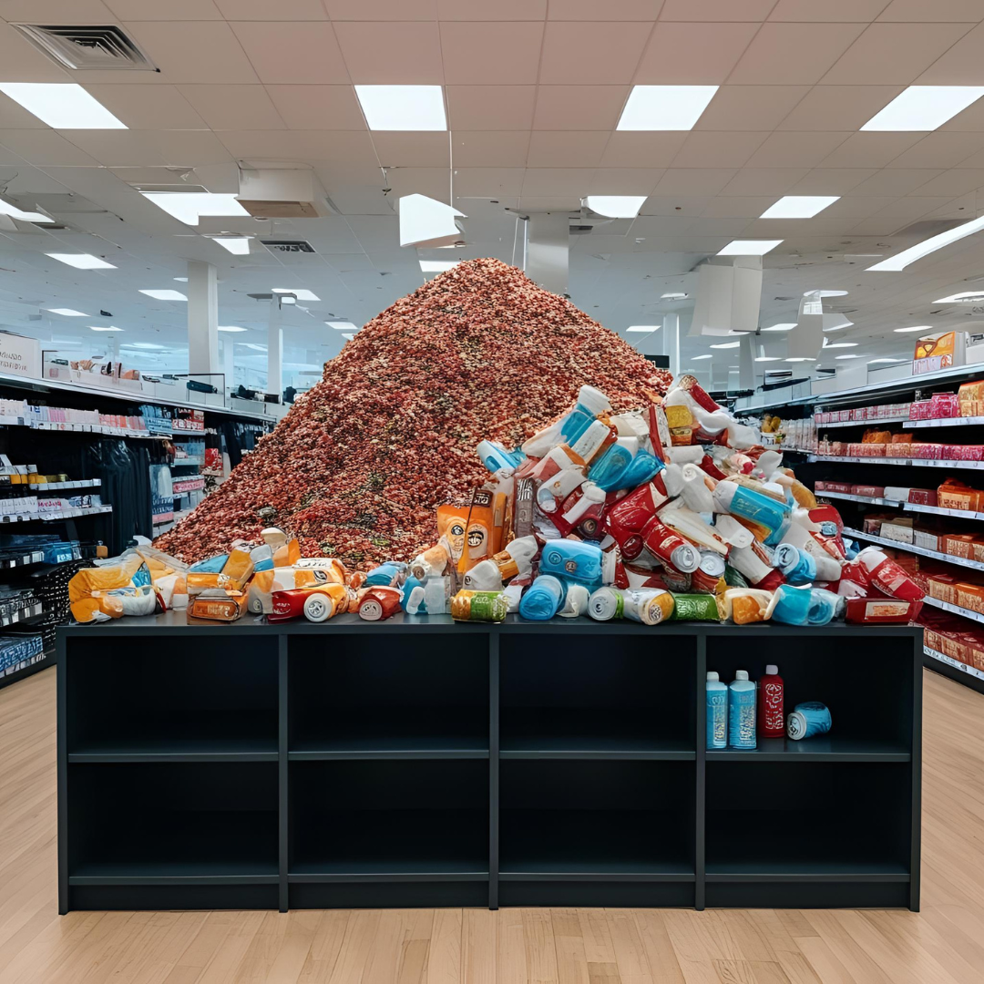
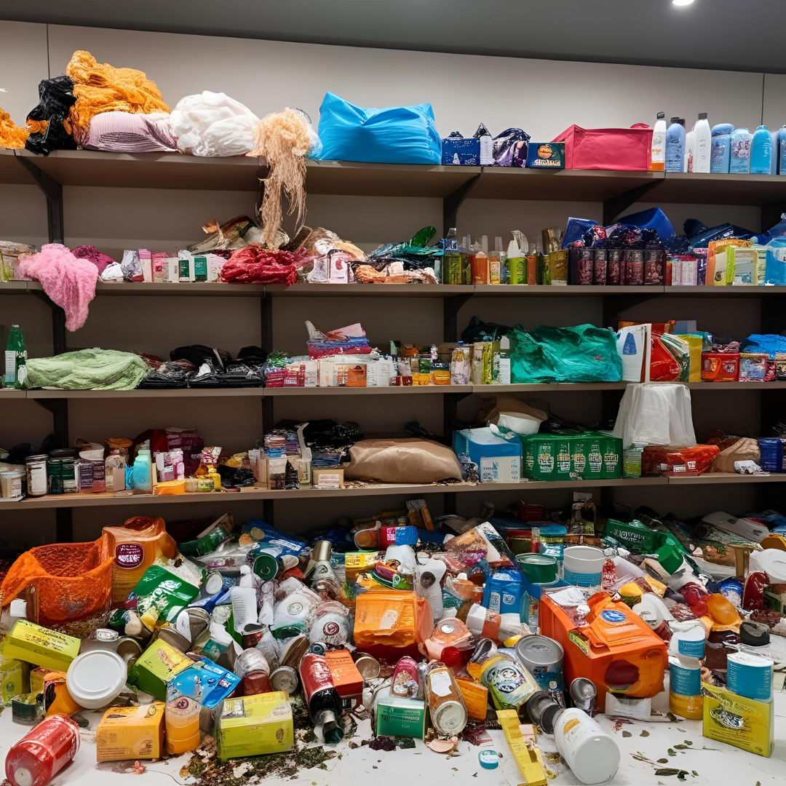
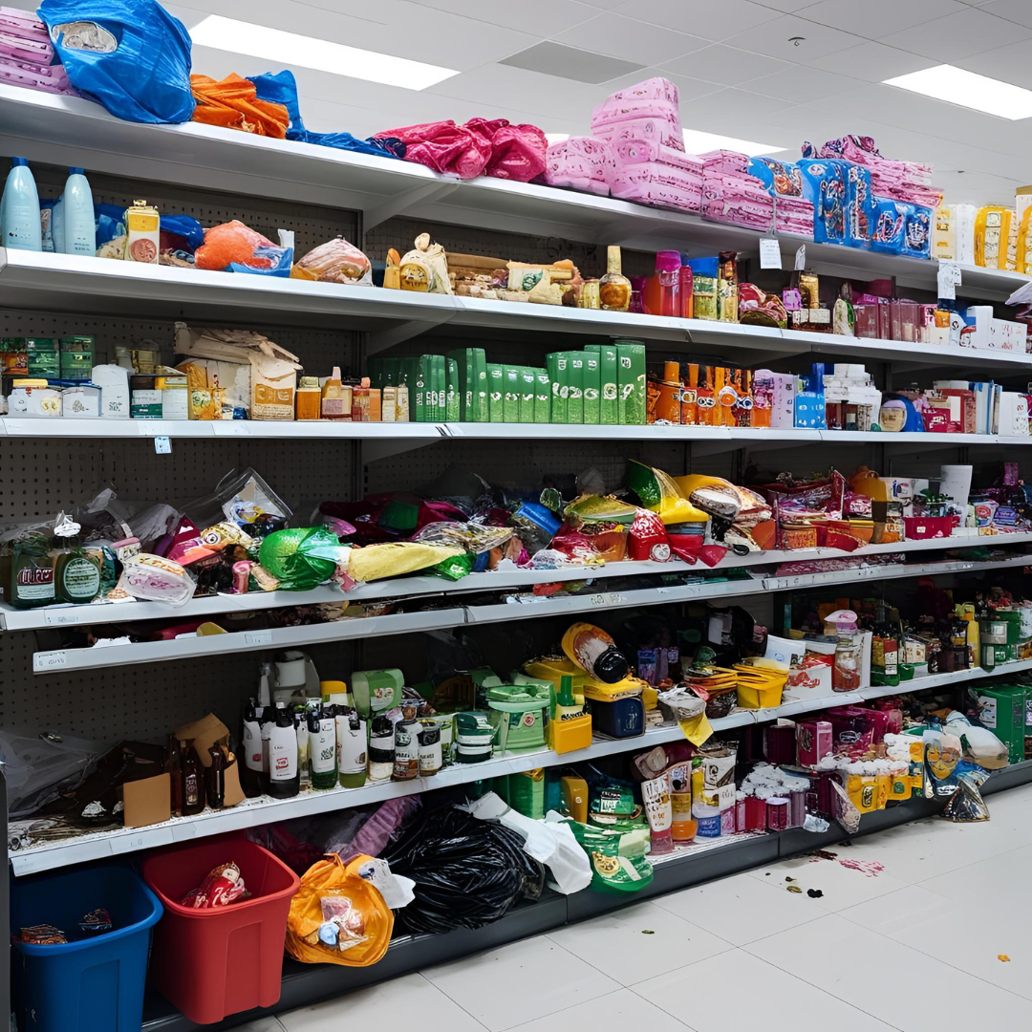
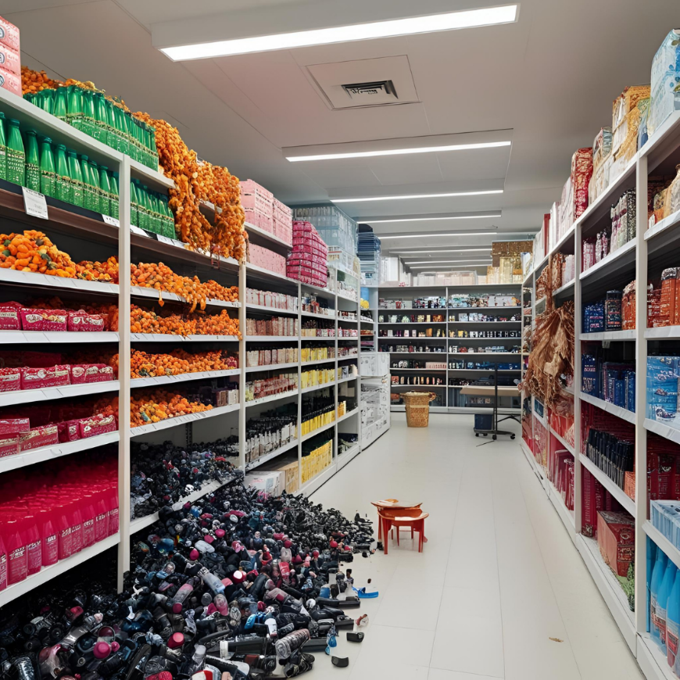
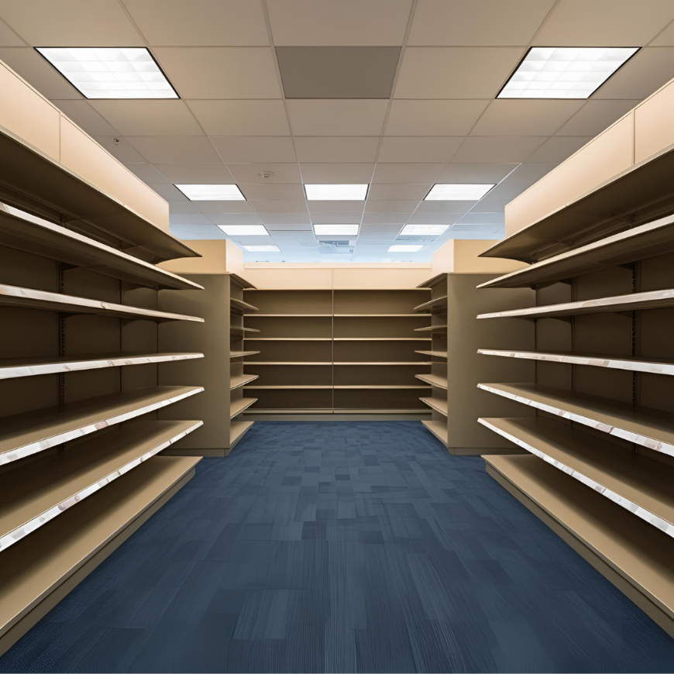
INTRODUCTION: CHAOS!

Slide 4





OUR COMPANY
ABOUT US:
Alpha is a cosmetic trading company with a national presence, offering high-
quality beauty products from trusted brands. We strive to make premium cosmetics accessible with competitive prices.
OUR VISION:
To become a leading supplier and top choice for premium cosmetic and beauty
products, renowned for our innovation and quality.
OUR MISSION:
To enable access to high-quality, diverse cosmetic products for customers,
delivering exceptional value and a seamless shopping experience.

Slide 5
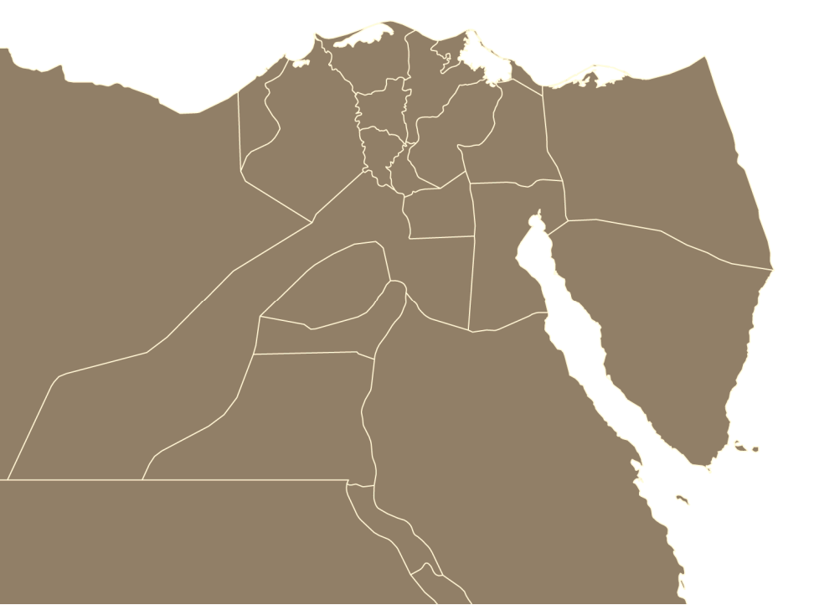



OUR LOCATIONS
Cairo warehouse
Nasr city retail store
5th settlement retail store
Suez warehouse
Port Said retail store
Suez retail store

Slide 6

PROBLEMS
Overstock/stockout
Slow approvals
Manual tracking errors
Unauthorized access
Miscommunication between departments
Supplier and customer management issues

Slide 7















BENEFITS OF ERP SYSTEMS
Enhanced security
Better data insights
Automating manual processes
Master data source
Resource management
Single version of the facts
Using data and analytics to drive decisions
Enhanced Collaboration across departments
Centralized item code or identifier

Slide 8

ORACLE SCM
AS THE ERP SYSTEM OF CHOICE

Slide 9


ORACLE SCM APPLICATIONS TO BE IMPLEMENTED
System Adminstration Ensures security by configuring & managing user access & permissions.
Inventory
Ensures real-time stock visibility & optimizes inventory operations.
Purchasing
Simplifies & automates purchasing processes enhancing purchasing control & tracking.

Slide 10
OPERATIONS OVERVIEW
The company follows a Buy-to-Sell business strategy.
Costing method is “average” in Both warehouses & retail stores.
Item cost in the warehouses is NOT the same as in the retail stores.
The target customers are individuals not retailers.
Customer can return purchased items to any retail store.
Both warehouses and retail stores use one item database.
Centralized procurement: All procurement requests are managed by a central purchasing department.

Slide 11

CHART OF ACCOUNTS
Segment
Qualifier
Company
01
Balancing sheet
Department
520
Cost center
Account
5210
Natural accounts
For the future
000

Slide 12

MULTI-ORGANIZATION STRUCTURE
Alpha Corporation – Business Group
Alpha corporation – General Ledger
Alpha Corporation – Legal Entity
Alpha co. OU – Operating Unit
Warehouses – Inventory Organization
Retail stores – Inventory Organization

Slide 13
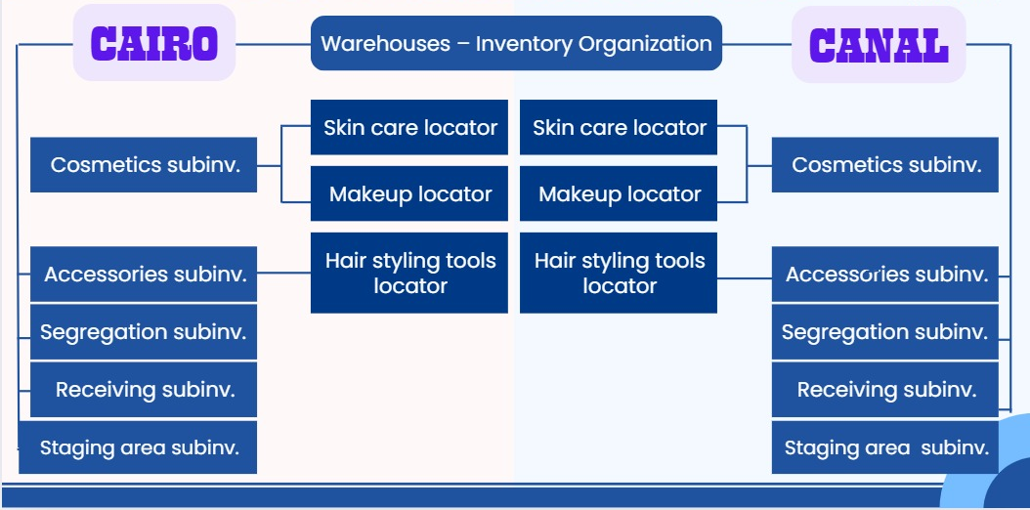
MULTI-ORGANIZATION STRUCTURE.
CAIRO
CANAL
Warehouses – Inventory Organization
Skin care locator
Skin care locator
Cosmetics subinv.
Cosmetics subinv.
Makeup locator
Makeup locator
Hair styling tools locator
Hair styling tools locator
Accessories subinv.
Accessories subinv.
Segregation subinv.
Segregation subinv.
Receiving subinv.
Receiving subinv.

Slide 14
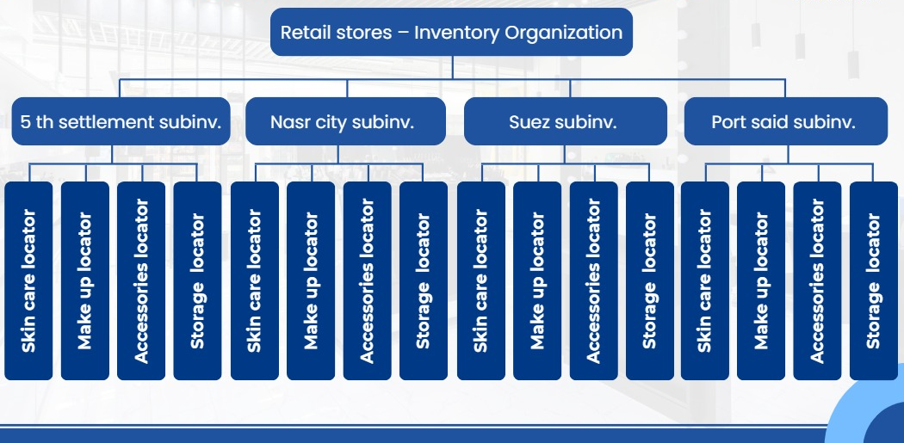
MULTI-ORGANIZATION STRUCTURE.
Retail stores – Inventory Organization
5 th settlement subinv.
Nasr city subinv.
Suez subinv.
Port said subinv.
Accessories locator
Accessories locator
Accessories locator
Accessories locator
Skin care locator
Make up locator
locator
Skin care locator
Make up locator
Skin care locator
Make up locator
locator
Skin care locator
Make up locator
Storage
Storage

Slide 15
TRANSACTIONS
CPA
Standard PO Min-max planning
5th settlement Retail
Cairo Warehouse
Nasr city Retail
Move order transfer
Min-max planning IR
In transit org. transfer
Suppliers
Suez Retail
CPA
Standard PO Min-max planning
Suez Warehouse
Port said Retail

Slide 16


THANKS

